Slide 1
Sorting

Slide 2
Counting Sort
Counting sort is a sorting technique based on keys between a specific range.
It works by counting the number of objects having distinct key values (a kind of hashing).
Then do some arithmetic operations to calculate the position of each object in the output sequence.

Slide 3
Contd.
Example:
Input size 10
Range is 6
Sort: 1, 5, 6, 2, 3, 2, 5, 1, 6, 2

Slide 4
Characteristics
Counting sort makes assumptions about the data, for example, it assumes that values are going to be in the range of 0 to 10 or 10 – 99, etc, Some other assumption counting sort makes is input data will be all integer numbers (workaround for floating point numbers is possible).
Like other algorithms this sorting algorithm is not a comparison-based algorithm, it hashes the value in a temporary count array and uses them for sorting.
It uses a temporary array making it a non-In Place algorithm.

Slide 5
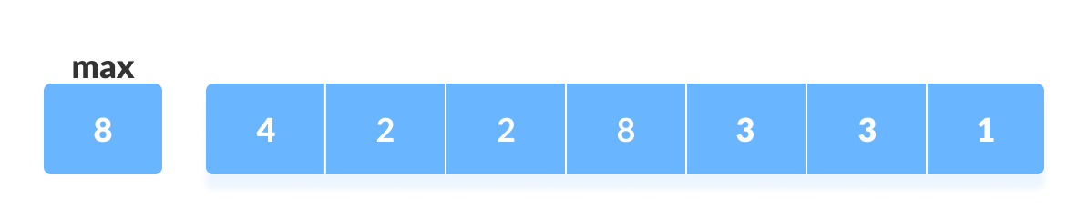
Example
For simplicity, consider the data in the range of 0 to 9.
Input data: {4, 2, 2, 8, 3, 3, 1}
Find out the maximum element (let it be max) from the given array.

Slide 6
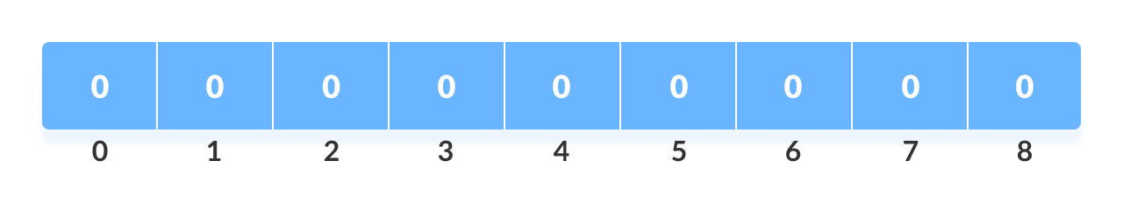
Contd.
Initialize an array of length max+1 with all elements 0. This array is used for storing the count of the elements in the array.

Slide 7
Contd.
Store the count of each element at their respective index in count array
For example: if the count of element 3 is 2 then, 2 is stored in the 3rd position of count array. If element "5" is not present in the array, then 0 is stored in 5th position.

Slide 8
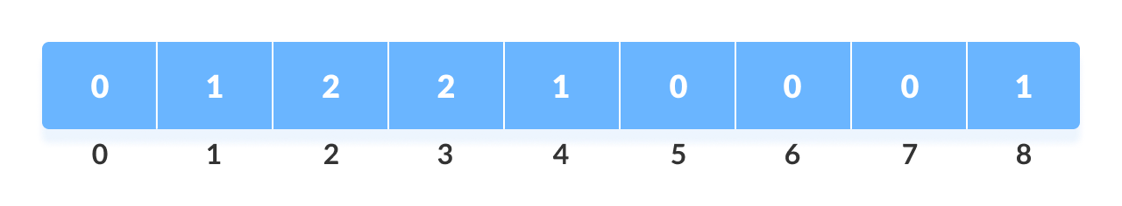
Contd.

Slide 9
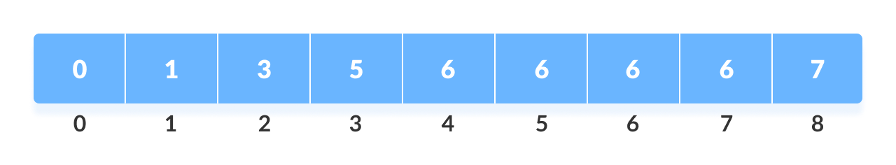
Contd.
Store cumulative sum of the elements of the count array. It helps in placing the elements into the correct index of the sorted array.

Slide 10
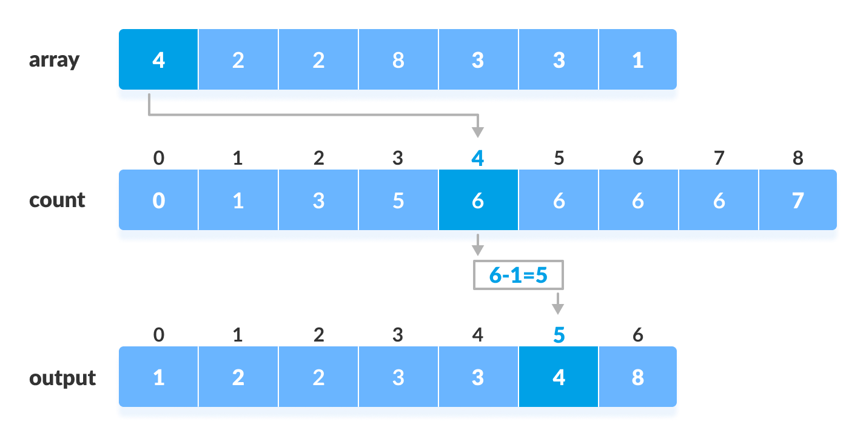
Contd.
Find the index of each element of the original array in the count array. This gives the cumulative count.

Slide 11
Contd.
After placing each element at its correct position, decrease its count by one.

Slide 12
Code: Python
# Counting sort in Python programming
def countingSort(array):
size = len(array)
output = [0] * size
# Initialize count array
count = [0] * 10
# Store the count of each elements in count array
for i in range(0, size):
count[array[i]] += 1
# Store the cummulative count
for i in range(1, 10):
count[i] += count[i - 1]
# Find the index of each element of the original array in count array
# place the elements in output array
i = size - 1
while i >= 0:
output[count[array[i]] - 1] = array[i]
count[array[i]] -= 1
i -= 1
# Copy the sorted elements into original array
for i in range(0, size):
array[i] = output[i]
data = [4, 2, 2, 8, 3, 3, 1]
countingSort(data)
print("Sorted Array in Ascending Order: ")
print(data)

Slide 13
Complexity
Best | Average | Worst
O(n+k) | O(n+k) | O(n+k)
Space
O(max)

Slide 14
Radix Sort
Radix sort is a sorting algorithm that sorts the elements by first grouping the individual digits of the same place value. Then, sort the elements according to their increasing/decreasing order.
Suppose, we have an array of 8 elements. First, we will sort elements based on the value of the unit place. Then, we will sort elements based on the value of the tenth place. This process goes on until the last significant place.

Slide 15
Steps
First, we have to find the largest element (suppose max) from the given array. Suppose 'x' be the number of digits in max. The 'x' is calculated because we need to go through the significant places of all elements.
After that, go through one by one each significant place. Here, we have to use any stable sorting algorithm to sort the digits of each significant place.

Slide 16
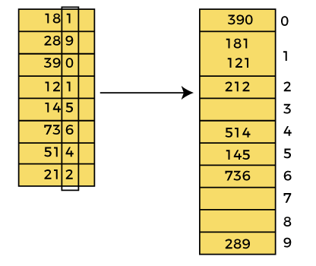

Pass 1

Slide 17
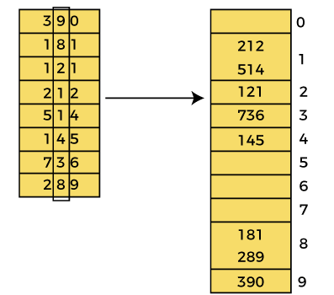

Pass 2

Slide 18
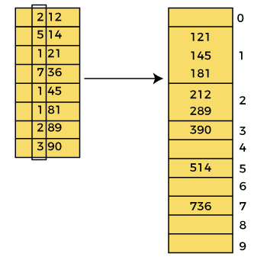

Pass 3

Slide 19
Code
def countingSort(arr, exp1):
n = len(arr)
output = [0] * (n)
count = [0] * (10)
for i in range(0, n):
index = arr[i] // exp1
count[index % 10] += 1
for i in range(1, 10):
count[i] += count[i - 1]
i = n - 1
while i >= 0:
index = arr[i] // exp1
output[count[index % 10] - 1] = arr[i]
count[index % 10] -= 1
i -= 1
i = 0
for i in range(0, len(arr)):
arr[i] = output[i]
def radixSort(arr):
max1 = max(arr)
exp = 1
while max1 / exp >= 1:
countingSort(arr, exp)
exp *= 10
arr = [170, 45, 75, 90, 802, 24, 2, 66]
radixSort(arr)
for i in range(len(arr)):
print(arr[i],end=" ")

Slide 20
Complexity Analysis
Best | Average | Worst
Ω(d*k) | θ(d*n) | O(d*n)
d is the number of digits in the largest number
n is the length of input
The time complexity is independent of whether the input is sorted or not.

